Slide 1
Institute of Chemical Kinetics and Combustion
Siberian Branch of the Russian Academy of Sciences

Slide 2




Presentation plan
General information
Research and structure
Achievements and recognition
My work in the laboratory
Conclusion

Slide 3

General information
The founded: June 21, 1957
The first director: Alexander Alekseevich Kovalsky
The current director: Onishchuk Andrey Alexandrovich

Slide 4
Research and structure
Chemical physics and radiation chemistry
Magnetic spin effects
Nanotechnology and medicine
Instruments and methods
Applied developments

Slide 5
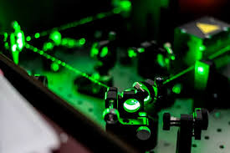

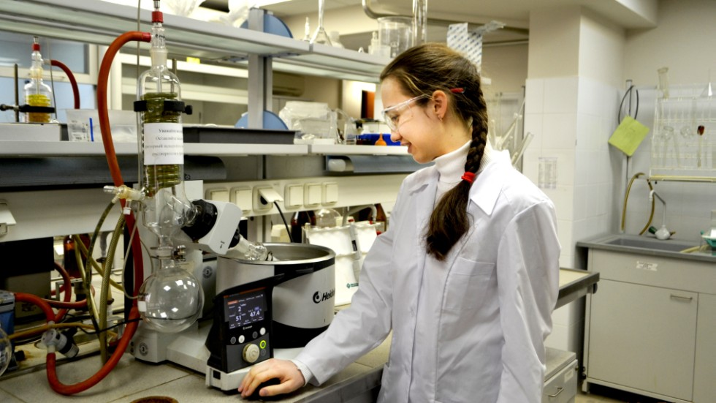
Achievements and recognition

Slide 6
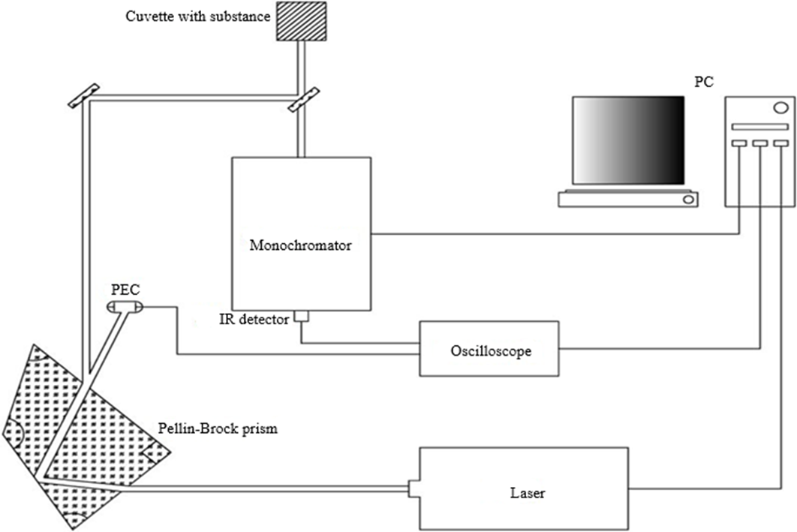
My work in the laboratory

Slide 7
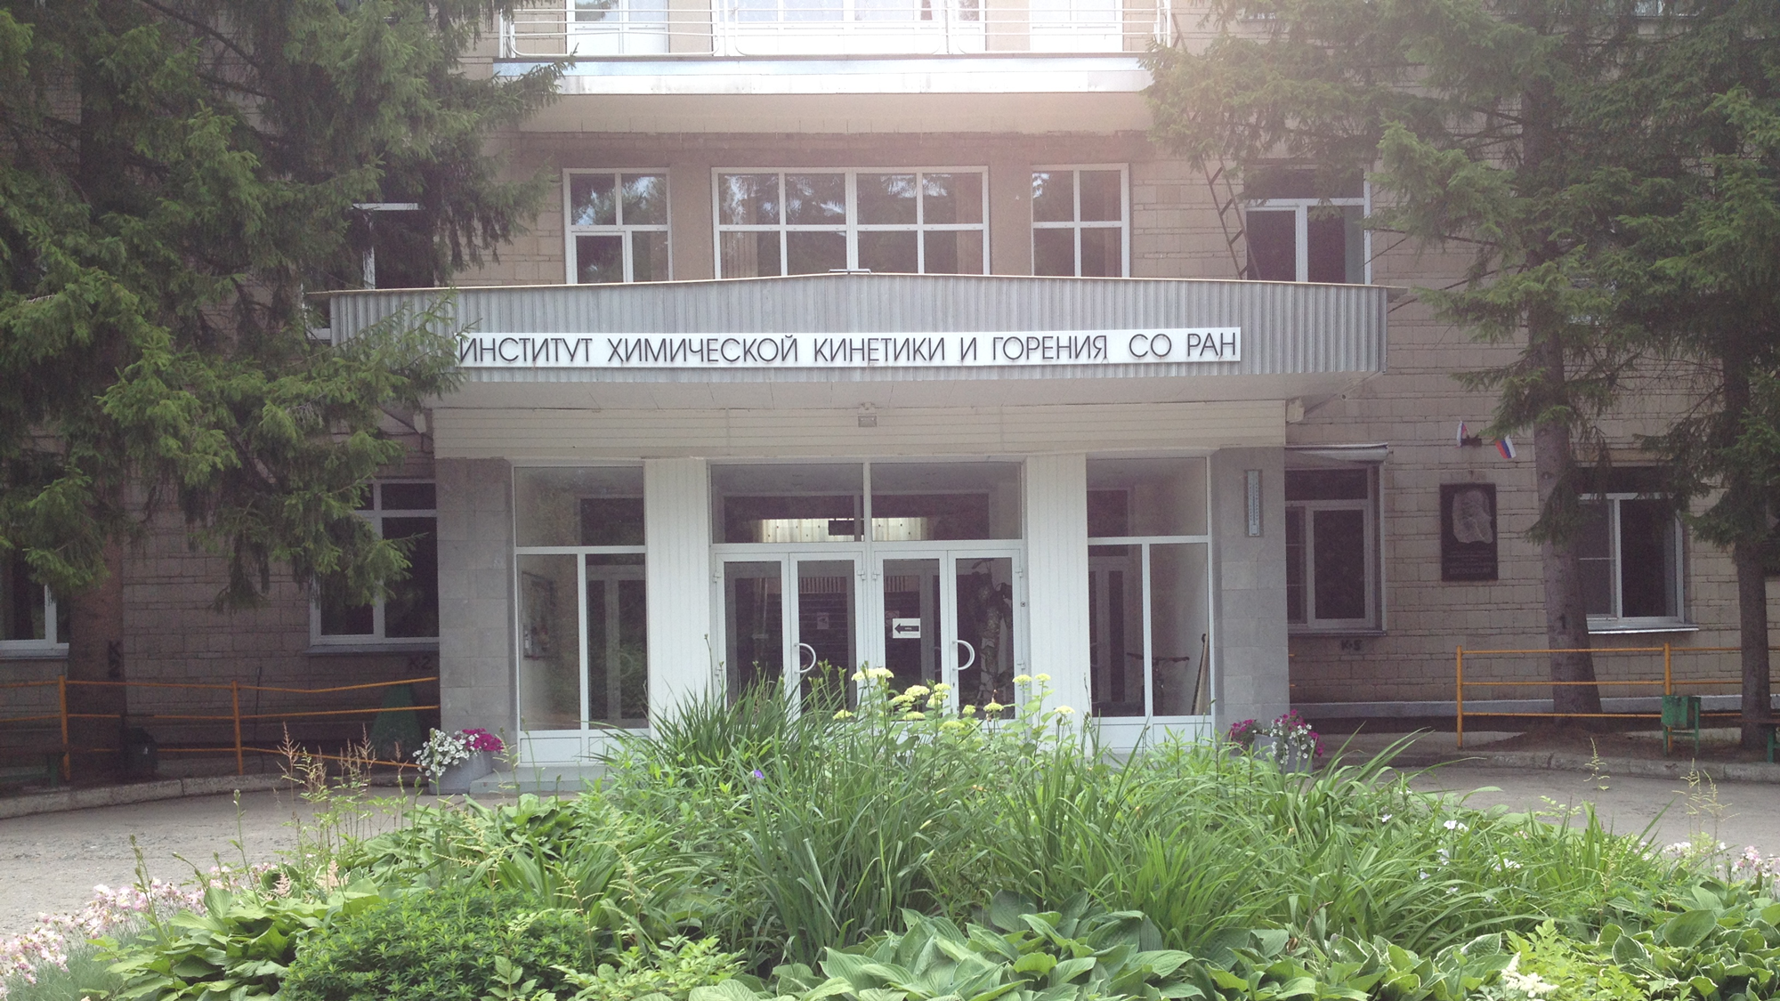
Conclusion

Slide 8
Thank you for your attention!

